Slide 1




Cybercrime and Digital Forensics (COM622)
Department of Science & Engineering
Solent University
Week 7 Lecture: Encryption and Hashing
Dr Daniel Olabanji

Slide 2

Session Overview
Encryption Recap
Type of Encryption
Hashing

Slide 3
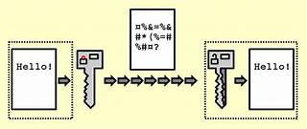
What is Encryption
Encryption is a method used to protect sensitive information by converting it into a code that can only be read by someone with the correct decryption key. This process ensures that even if data is intercepted, it remains unreadable to unauthorized users.
Encryption is widely used to secure online transactions, protect personal data, and ensure privacy in communication.
Encryption is aim to provide
  Confidentiality
  Authentication
  Integrity
  Non-repudiation

Slide 4
Key Terminology in Encryption
Plaintext: The original, readable data (e.g., a message or file).
Encryption Algorithm: A set of rules that transforms the plaintext into ciphertext.
Ciphertext: The encrypted, unreadable data.
Decryption Key: A secret key used to convert the ciphertext back into plaintext.

Slide 5
Type of Encryption
Symmetric Encryption
Asymmetric Encryption.
Other (e.g. Hashing)
Symmetric Encryption
Ceaser
Blowfish/Twofish
AES(Advanced Encryption Standard)
3DES (Tripple Data Encryption Standard)
Asymmetric Encryption
PGP(Pretty Good Privacy)
RCA(Rivest-Shamir-Adleman)
ECC ( Elliptic Curve Cryptography)
Other Encryption
MD5(Message Digest Algorithm 5)
SHA(Secure Hash Algorithms)
TLS/SSL (Transport Layer Security/ Secure sockets layer)
IPsec(Internet Protocol Security)

Slide 6
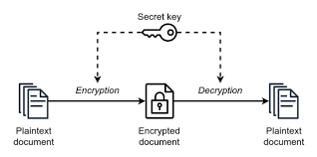
Symmetric Encryption
Symmetric Encryption: Uses the same key for both encryption and decryption. It’s fast and efficient but requires secure key distribution.

Slide 7
Encryption Symmetric Techniques: A Ceaser Cipher
The Caesar Cipher is one of the simplest and oldest encryption techniques. Named after Julius Caesar, who used it in his private correspondence, this cipher involves shifting each letter in the plaintext by a fixed number of positions down the alphabet.
How it works:
Choose a Shift Key: Decide on the number of positions each letter will be shifted. For example, a shift of 3.
Encrypt the Message: Replace each letter in the plaintext with the letter that is a fixed number of positions down the alphabet. For instance, with a shift of 3, A becomes D, B becomes E, and so on.
Decrypt the Message: To decrypt, shift the letters back by the same number of positions.

Slide 8
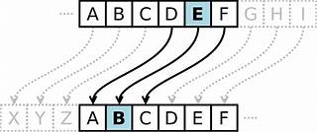
Encryption Symmetric Techniques: A Ceaser Cipher
For example, using a shift of 3:
Plaintext: HELLO
Ciphertext: KHOOR
The Caesar Cipher is a type of substitution cipher and is easy to break with modern techniques, but it was quite effective in its time.
Note: Brute force attack and dictionaries attack can be used to get the plaintext
Notes:
Show the example in class

Slide 9
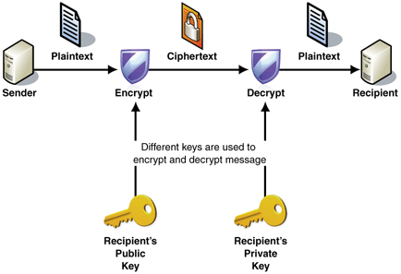
Asymmetric Encryption
Asymmetric Encryption: Uses a pair of keys (public and private). The public key encrypts the data, and the private key decrypts it. This method is more secure but slower.
Notes:
Show the example in class

Slide 10
Encryption Asymmetric Techniques: PGP (Pretty Good Privacy)
Pretty Good Privacy (PGP) is an encryption program that provides cryptographic privacy and authentication for data communication. It was developed by Phil Zimmermann in 1991 and is widely used for securing emails, files, and other forms of data.
Key Features of PGP
Hybrid Cryptosystem: PGP combines both symmetric-key and public-key encryption. The message is encrypted using a symmetric encryption algorithm, and the symmetric key is then encrypted with the recipient’s public key.
Digital Signatures: PGP uses digital signatures to verify the authenticity and integrity of the message. This ensures that the message has not been altered and confirms the sender’s identity.
Web of Trust: Unlike the hierarchical certificate authority model, PGP uses a decentralized trust model known as the web of trust. Users can sign each other’s keys, creating a network of trust.
Notes:
Show the example in class

Slide 11
Encryption Asymmetric Techniques: PGP (Pretty Good Privacy)
How PGP Works
Encryption: The sender encrypts the message with a symmetric key. This symmetric key is then encrypted with the recipient’s public key and sent along with the encrypted message.
Decryption: The recipient uses their private key to decrypt the symmetric key. This symmetric key is then used to decrypt the message.
Applications
Email Security: PGP is commonly used to encrypt and sign emails, ensuring that only the intended recipient can read the message and that the message has not been tampered with.
File Encryption: PGP can also be used to encrypt files and directories, providing an additional layer of security for sensitive data.
PGP has evolved over the years and is now compatible with various systems and standards, including OpenPGP.
Notes:
Show the example in class

Slide 12
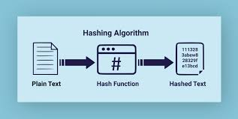
Hashing
Hashing: is a one-way process of transforming any given keyor plain text is mapped to a fixed length value. This is usually represented by a shorter, fixed-length value or key that represents and makes it easier to find or employ the original string.
Notes:
Show the example in class

Slide 13
Hashing (How Hashing Works)
Input Data: The original data, also known as the key, can be of any length and format (e.g., text, numbers, files).
Hash Function: This function takes the input data and processes it to produce a fixed-length hash value. Common hash functions include SHA-256, MD5, and SHA-1.
Hash Value: The output of the hash function, which is a unique string of characters representing the input data.
Characteristics of Hashing
Deterministic: The same input will always produce the same hash value.
Fixed Length: Regardless of the input size, the hash value will always be of a fixed length.
Efficient: Hash functions are designed to be fast and efficient.
Pre-image Resistance: It should be computationally infeasible to reverse the hash function and retrieve the original input from the hash value.
Collision Resistance: It should be rare for two different inputs to produce the same hash value.
Notes:
Show the example in class

Slide 14
Application of Hashing and Common Functions
Data Integrity: Ensuring that data has not been altered. For example, verifying file integrity.
Password Storage: Storing hashed passwords instead of plaintext passwords to enhance security.
Digital Signatures: Verifying the authenticity and integrity of a message or document.
Hash Tables: Efficiently storing and retrieving data in databases and other data structures.
Hash Functions
MD4 and MD5 by Ron Rivest (1990,1994)
SHA-0, SHA-1, SHA-3by NSA (1993, 1995)
RIPEMD-160 (1996)
SHA-2 (2002 – 224, 256, 385, 512)
Whirlpool
Tiger and GOST-3411
Notes:
Show the example in class

Slide 15
Hashing:MD5 (Message Digest Algorithm 5)
Invented in 1991 by Ron Rivest
Produces a 128-bit hash from an arbitrary length input.
Widely used
  File hashes
  Authentication
  Cryptographic signatures (including SSL)
The message length needs to be congruent to 448 mod 512.
  Padding is always performed
  Append a 1, followed by zeros until congruent.
  Append message length as 64bit integer.
Result is congruent 0 mod 512.
Notes:
Show the example in class

Slide 16
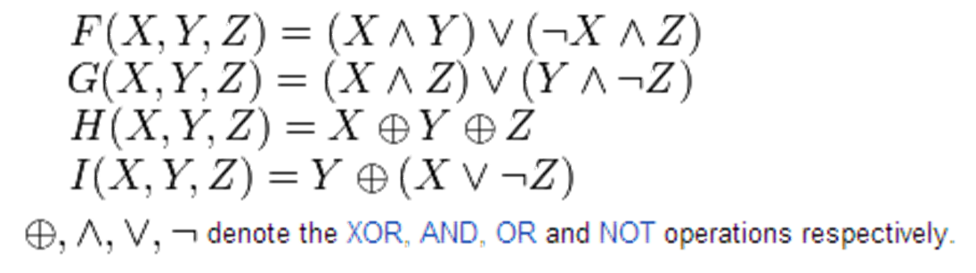
MD5 round Functions
64 rounds – each round works on a 32bit block
For each 16 rounds, use next ‘round function’.
Notes:
Show the example in class

Slide 17
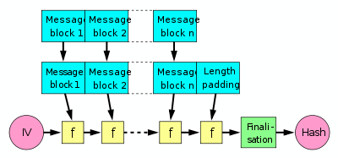
Processing Multiples of 512bits
Merkle–Damgård construction
Notes:
Show the example in class

Slide 18
Weaknesses in MD5
Weaknesses now known in MD5
  Possible to calculate a message such that they produce the same hash
  Breaks security of SSL which rely on ‘signed’ hashes to verify sender/authenticity.
  Hacking the hash
I want to produce two contracts that when hashed – produce the same hash.
  A – Alice agrees to give £1000 to Bob for £1
  B – Alice agrees to give £2000 to Bob and her house for £1
I will ask Alice to sign contract A, but if they both hash to the same thing, I can swap them at a later date and they’ll verify as correct.
One would expect this to have complexity 2^{n} where n is the size in bits of the has
Notes:
Show the example in class

Slide 19
Conclusions
Hash functions produce fixed output
Hard to compute two messages with the same hash
MD5 based on series of rounds and round functions.
MD5 uses Merkle–Damgård construction
Hash collisions can happen with 2^{n/2} probability due to birthday attack
Notes:
Show the example in class

